Slide 1
Title: Prison Monitoring using IoT and Edge Computing
B.Tech ECE (Spec. in IoT and Sensor)
FINAL YEAR PROJECT -FIRST REVIEW
Team Member Details:
16BIS0072 - Sangeeth Kumar V
16BIS0088 - Abhishek Kishore Yadav
Faculty Guide:
Karthikeyan A, Assistant Professor (Senior), Department of Embedded Technology, SENSE, VIT Vellore.

Slide 2
Abstract
Problem Statement: In most of the prisons, inmates outnumber security personals with the ratio approximately 5:1. So its difficult to monitor each and every activity of prisoners 24/7 and there is a high probability to miss suspicious activities.
Problem Solution: We can observe and note down the activities of prisoners 24/7, if an automated system is used, designed to supervise the inmates and the people they come in contact with, during their sentence, we can assist and ease up the monitoring task of the prison staffs.
Our proposed system will perform the following tasks :-
Prisoners Activity Management
Visitor Management
Access and Control Management
MIS (Management Information Systems) reports

Slide 3
Objective
Our project aims to develop a prison monitoring system that uses the concept of edge computing and IoT.
The edge devices can be deployed across the prison facility using edge devices like raspberry pi connected to the central command center. These edge devices reduce the computation load and make the system flexible in terms of deployment.
Computer vision will be used to monitor prisoners using facial recognition and object detection.
Cloud computing will be used to store and analyze the data captured through these distributed edge devices.

Slide 4
Current Status and Motivation
Existing Techniques | Pros | Cons
Check posts | Effective in monitoring people entering and exiting certain prison facilities. | Hard to monitor activities happening inside the facility. Prone to Human errors Cannot detect individual person’s location and activity.
Biometrics | Easier to implement access control across facilities. Difficult to bypass. | Costly and hard to implement across the entire facility. Limited functionality and deployment.
RFID Tags | Easy to track specific individual movements. Increases monitoring range | Tags can be tampered with even if its implanted and can be easily used to deceive the system.
Motivation: Computer vision combined with edge computing nodes helps us overcome the cons experience with the use of existing methods and offer an efficient monitoring system.

Slide 5
Hardware and Software details
Hardware used:
Raspberry pi (Edge device)
Camera
Software tools:
Python
OpenCV (Library)
Other tools for developing GUI - JS, ReactJS framework, Android Studio, etc..

Slide 6
Expected Outcome
The system is expected to monitor prisoner’s day to day activities efficiently so that it can warn the necessary personal about the suspicious activities and able to predict and inform prison breaks and fights between inmates.
The system effectively reduces the network load incurred by localizing the computation load across the edge devices attached and reduce network congestion which will inturn improve the latency incurred carrying the data to the cloud.
The GUI utility tools also enable for an easier interface to access and observe the analyzed data for routine checkups.

Slide 7
Methodology
Camera captures the raw pixel frames across the facility and feed it to the connected or nearest edge device. (Raspberry Pi)
Edge devices (Raspi) collects and preprocess the raw pixel data, performs basic recognition and send the formatted data to the cloud.
Cloud takes in the data received from the edge devices, indexes and performs further analytics.
GUI tools receives the analyzed data from the cloud and delivers a human interface for monitoring the activities of prisoners in real time and visualize the past activity sequences.

Slide 8
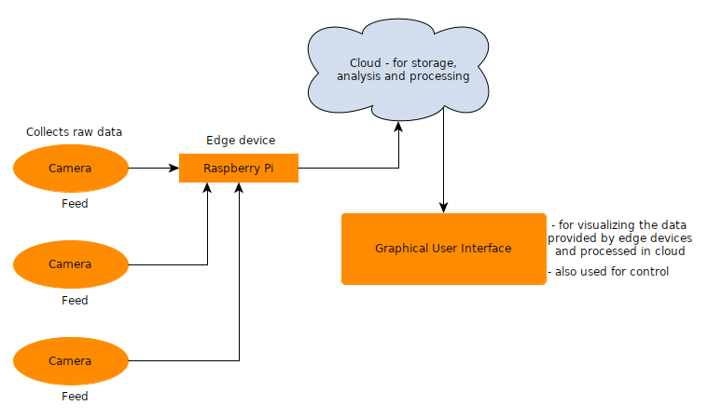
Block Diagram

Slide 9
Timeline
Month | Target
2nd December 2020- 19th December 2020 | Propose and provide basic design concept
4th January 2020-31st January 2020 | Implement all mentioned software functionalities.
1st February 2020- 29th Febuary 2020 | Deliver an integrated hardware prototype
1st March 2020- 20th March 2020 | Debug errors and improve if required.
First week of April | Deliver full project

Slide 10
References
Liu, Y.X., Yang, Y., Shi, A., Jigang, P. and Haowei, L., 2019, February. Intelligent monitoring of indoor surveillance video based on deep learning. In 2019 21st International Conference on Advanced Communication Technology (ICACT) (pp. 648-653). IEEE. https://ieeexplore.ieee.org/abstract/document/8701964
Zhou, W., Xuehua, Z., Xin, X. and Jiande, W., 2010, April. The application research of wireless sensor network in the prison monitoring system. In 2010 Third International Symposium on Intelligent Information Technology and Security Informatics (pp. 58-62). IEEE. https://ieeexplore.ieee.org/abstract/document/5453649
Vijayaragavan, P., Ponnusamy, R., Arramuthan, M. and Vijila, T., 2018. RSSI-Based ZIGBEE Independent Monitoring System in Prison for Prisoners. In Information Systems Design and Intelligent Applications (pp. 20-28). Springer, Singapore. https://link.springer.com/chapter/10.1007/978-981-10-7512-4_3
Cynthia, J. and Priya, C.B., 2018. IoT based Prisoner Escape Alert and Prevention system. International Journal of Pure and Applied Mathematics, 120(6), pp.11543-11554. https://acadpubl.eu/hub/2018-120-6/8/766.pdf
Kaur, M.J., Riaz, S. and Mushtaq, A., 2020. Cyber-Physical Cloud Computing Systems and Internet of Everything. In Principles of Internet of Things (IoT) Ecosystem: Insight Paradigm (pp. 201-227). Springer, Cham.
Selamat, M.S. and Majlis, B.Y., 2006, December. Considering RFID inmate tagging application to enhance prison management. In 2006 IEEE International Conference on Semiconductor Electronics (pp. 253-257). IEEE. https://ieeexplore.ieee.org/abstract/document/4266609

Slide 11
Wei, W.E.I., Yang, L.I.U., MAI, H.H. and ZHANG, W.Q., 2017. An Effective Device Integration Middleware in Prison IoT. DEStech Transactions on Engineering and Technology Research, (amma). http://dpi-proceedings.com/index.php/dtetr/article/view/13373
Meng, Z.J. and Jie, C., 2015. Design on Intelligent Video Surveillance System Based on Target Identification Algorithm. In Applied Mechanics and Materials (Vol. 713, pp. 460-465). Trans Tech Publications. https://www.scientific.net/AMM.713-715.460
Sun, P., Wei, W. and Xia, M., 2013. A Semantic Framework for Integration of Prison Internet. In Intelligence Computation and Evolutionary Computation (pp. 767-771). Springer, Berlin, Heidelberg. https://link.springer.com/chapter/10.1007/978-3-642-31656-2_102
Li, X., 2013. Design of Security and Monitoring System for Prison Based on Wireless Sensor Networks. In Geo-Informatics in Resource Management and Sustainable Ecosystem (pp. 119-127). Springer, Berlin, Heidelberg. https://link.springer.com/chapter/10.1007/978-3-642-45025-9_14

Slide 12
THANK YOU

